Slide 1

Internship Project
on
Website and Application Development for Vegetable Market Logs
Project Manager and Mentor:
Mr. Yuvraj Joshi
Assistant Professor,
Department of Computer Science & Engineering
Graphic Era Deemed to be University, Dehradun,
Uttarakhand, India (248002)

Slide 2
Content Day 5
JS Reg-Ex (Regular Expression)
JS Reg-Ex (Examples)
JavaScript (JS) is preferred and its popularity
Node JS
Node JS (working)
Node JS vs Other REs
Installing Node.js and Setting Up a Dev Environment
Getting Started with Node JS

Slide 3
JS Reg-Ex (Regular Expression)
Regular expressions are defined using a combination of characters and special symbols called metacharacters. Here are the commonly used regular expression notations in JavaScript:
1. Literal Characters:
Literal characters represent themselves in a regular expression. For example, the regular expression `/hello/` matches the literal string "hello".

Slide 4
JS Reg-Ex (Regular Expression)
2. Metacharacters:
Metacharacters have special meanings and are used to define patterns in regular expressions. Some common metacharacters are:
- `.` (dot): Matches any single character except for line breaks.
- `|` (pipe): Acts as an OR operator, matching either the expression before or after the pipe.
- `[ ]` (square brackets): Defines a character set, matching any one character from within the brackets.
- `[^ ]` (caret within square brackets): Defines a negated character set, matching any character not in the brackets.
- `\` (backslash): Escapes a metacharacter, treating it as a literal character. For example, `\.`, `\[`, etc.

Slide 5
JS Reg-Ex (Regular Expression)
3. Character Classes:
Character classes allow you to match specific groups of characters. Some common character classes are:
- `\d`: Matches any digit character (0-9).
- `\w`: Matches any alphanumeric character (a-z, A-Z, 0-9, and underscore `_`).
- `\s`: Matches any whitespace character (space, tab, newline, etc.).
- `\D`, `\W`, `\S`: Negated versions of `\d`, `\w`, `\s` respectively (matching any character that is not a digit, alphanumeric, or whitespace).

Slide 6
JS Reg-Ex (Regular Expression)
4. Quantifiers:
Quantifiers specify the number of times a character or group can occur. Some common quantifiers are:
- `*`: Matches zero or more occurrences of the preceding character or group.
- `+`: Matches one or more occurrences of the preceding character or group.
- `?`: Matches zero or one occurrence of the preceding character or group.
- `{n}`: Matches exactly n occurrences of the preceding character or group.
- `{n,}`: Matches n or more occurrences of the preceding character or group.
- `{n,m}`: Matches between n and m occurrences of the preceding character or group.

Slide 7
JS Reg-Ex (Regular Expression)
5. Anchors:
Anchors are used to match a specific position within a string. Some common anchors are:
- `^`: Matches the start of a string.
- `$`: Matches the end of a string.
- `\b`: Matches a word boundary.
- `\B`: Matches a position that is not a word boundary.

Slide 8
JS Reg-Ex (Regular Expression)
6. Groups and Capturing:
Groups are used to create subexpressions and capture parts of a string. They are denoted by parentheses `( )`. Capturing groups allow you to extract specific parts of a matched string. For example, `(abc)` captures the sequence "abc" as a group.

Slide 9
JS Reg-Ex (Examples)
1. Matching a Literal String:
const regex = /hello/;
console.log(regex.test("hello world")); // true
console.log(regex.test("hi there")); // false
In this example, the regular expression `/hello/` matches the literal string "hello". The regex is enclosed between two forward slashes `/` to indicate that it is a regular expression literal. The `test()` method is then used to check if the regex matches a given string. In the first test case, the string "hello world" contains the word "hello," so the regex test returns `true`. In the second test case, the string "hi there" does not contain "hello," so the regex test returns `false`.

Slide 10
JS Reg-Ex (Examples)
2. Matching Any Character:
const regex = /./;
console.log(regex.test("abc")); // true
console.log(regex.test("123")); // true
console.log(regex.test("")); // false
The dot `.` in a regular expression matches any single character (except for line breaks). In this example, the regular expression `/./` matches any character present in the string. The first two test cases return `true` because "abc" and "123" contain at least one character. The third test case returns `false` because the empty string does not contain any characters.

Slide 11
JS Reg-Ex (Examples)
3. Matching a Character Set:
const regex = /[aeiou]/;
console.log(regex.test("hello")); // true
console.log(regex.test("wrld")); // false
The character set `[aeiou]` matches any one character that is either 'a', 'e', 'i', 'o', or 'u'. It allows you to specify a set of characters from which the regex can match. In this example, the regular expression `/[aeiou]/` matches the first vowel encountered in the string. The first test case returns `true` because "hello" contains the vowel 'e'. The second test case returns `false` because "world" does not contain any of the specified vowels.

Slide 12
JS Reg-Ex (Examples)
4. Matching a Range of Characters:
const regex = /[0-9]/;
console.log(regex.test("abc123")); // true
console.log(regex.test("xyz")); // false
The character range `[0-9]` matches any digit from 0 to 9. It allows you to match a single character within a specified range. In this example, the regular expression `/[0-9]/` matches the first digit encountered in the string. The first test case returns `true` because "abc123" contains the digit '1'. The second test case returns `false` because "xyz" does not contain any digits.

Slide 13
JS Reg-Ex (Examples)
5. Matching Repetitions:
const regex = /a+/;
console.log(regex.test("abc")); // true
console.log(regex.test("bcd")); // false
The `+` quantifier matches one or more occurrences of the preceding character or group. In this example, the regular expression `/a+/` matches one or more 'a' characters. The first test case returns `true` because "abc" contains one 'a'. The second test case returns `false` because "bcd" does not contain any 'a' characters.

Slide 14
JS Reg-Ex (Examples)
6. Matching Word Boundaries:
const regex = /\bcat\b/;
console.log(regex.test("cat")); // true
console.log(regex.test("scatter")); // false
The `\b` boundary asserts that the match must occur on a word boundary. It allows you to match whole words. In this example, the regular expression `/\bcat\b/` matches the exact word "cat," but it does not match words that contain "cat" as a substring. The first test case returns `true` because "cat" is an exact match. The second test case returns `false` because "scatter" contains "cat" as part of the word, but not as a standalone word.

Slide 15
JavaScript (JS) is preferred and its popularity
1. Versatility: JS is a versatile programming language that can be used for both front-end and back-end development. It runs in web browsers, making it the primary language for creating interactive and dynamic web applications.
2. Ubiquity: JavaScript is supported by all modern web browsers, making it universally accessible to users across different platforms and devices. This widespread adoption has contributed to its popularity.

Slide 16
JavaScript (JS) is preferred and its popularity
3. Ease of Learning: JavaScript has a relatively low entry barrier, making it accessible to beginners. Its syntax is similar to other popular programming languages, such as C and Java, which helps developers transition and learn JS quickly.
4. Large Developer Community: JavaScript has a vast and active developer community. This means there are abundant resources, libraries, and frameworks available to assist developers in solving problems and accelerating the development process.

Slide 17
JavaScript (JS) is preferred and its popularity
5. Front-End Interactivity: JS enables dynamic content updates, interactivity, and enhanced user experiences on the front end. With frameworks like React and Angular, developers can build complex and interactive user interfaces efficiently.
6. Server-Side Development: With the introduction of Node.js, JavaScript can be used for server-side development as well. This allows developers to use a single language for both front-end and back-end, leading to increased productivity and code reusability.

Slide 18
JavaScript (JS) is preferred and its popularity
7. Frameworks and Libraries: JavaScript has a wide range of frameworks and libraries, such as React, Angular, Vue.js, and Express.js, which provide powerful tools and features for web development. These frameworks simplify complex tasks and speed up the development process.
8. Continuous Improvement: JavaScript has evolved significantly over the years. Regular updates and new language features keep JS relevant and adaptable to modern development needs. This continuous improvement ensures that JavaScript remains a popular choice for developers.

Slide 19
Node JS
Node.js is a runtime environment that allows developers to run JavaScript code outside of a web browser, enabling server-side development. Here are the key points explaining Node.js, its emergence, and its impact on web development:
1. JavaScript Runtime: Node.js provides a JavaScript runtime environment built on the V8 JavaScript engine, which was developed by Google for use in the Chrome web browser. It allows developers to execute JavaScript code on the server side.

Slide 20
Node JS
2. Event-Driven and Non-Blocking I/O: Node.js is designed to be event-driven and non-blocking, meaning it can handle a large number of concurrent connections efficiently. This architecture allows for scalable and high-performance applications, making it ideal for handling real-time applications, APIs, and streaming data.
3. Emergence: Node.js was created by Ryan Dahl in 2009. He aimed to develop a server-side technology that could provide high scalability and handle concurrent connections effectively. Dahl took the V8 engine and built a lightweight, event-driven framework around it, resulting in Node.js.

Slide 21
Node JS
4. Single-Language Development: Prior to Node.js, JavaScript was primarily used for front-end development in web browsers. Node.js introduced the concept of using JavaScript on the server side, allowing developers to use a single language (JavaScript) for both client-side and server-side development. This greatly simplified the development process and improved code reusability.
5. NPM (Node Package Manager): Node.js comes with the powerful npm package manager, which is one of its key strengths. npm allows developers to easily install, manage, and share reusable JavaScript libraries and frameworks, significantly accelerating the development process. The npm registry hosts thousands of open-source packages, making it a valuable resource for developers.

Slide 22
Node JS
6. Microservices and APIs: Node.js is well-suited for building microservices and developing RESTful APIs. Its lightweight and efficient nature, combined with its non-blocking I/O capabilities, make it an excellent choice for creating scalable and performant backend systems.
7. Real-time Applications: Node.js excels in handling real-time applications that require bidirectional communication, such as chat applications, collaborative tools, and gaming platforms. Its event-driven architecture and support for WebSockets enable developers to build responsive and interactive real-time applications.

Slide 23
Node JS
8. Large and Active Community: Node.js has a vibrant and active developer community. This community contributes to the growth and improvement of Node.js by creating and maintaining numerous libraries, frameworks, and tools. The availability of a wide range of resources and support fosters innovation and simplifies the development process.
Node.js has revolutionized web development by allowing JavaScript to be used on the server side. Its scalability, high performance, and single-language development have made it a popular choice for building fast, efficient, and real-time applications.

Slide 24
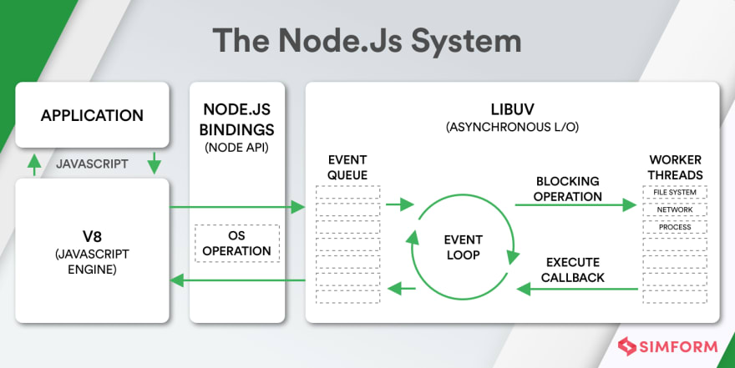
Node JS (Working)

Slide 25
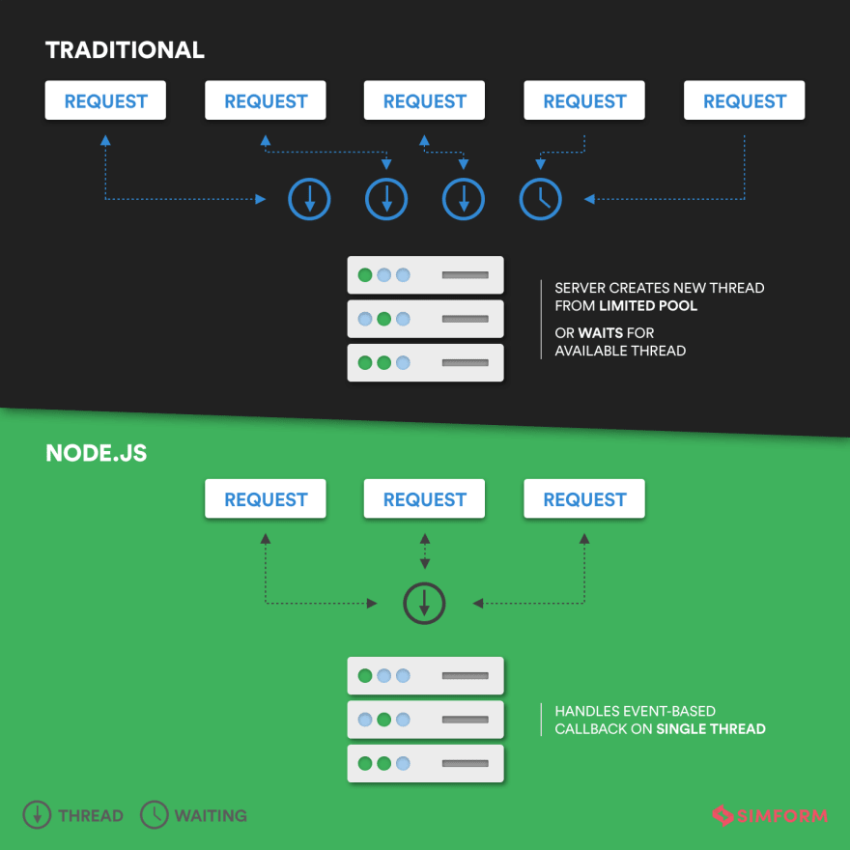
Node JS (Working)

Slide 26
Node JS (Working)
Node.js is a single-threaded, event-driven runtime environment that handles requests asynchronously and uses non-blocking I/O operations. Its working can be summarized as follows:
1. Node.js accepts client requests and sends responses.
2. It handles requests with a single thread, using the concept of threads to perform I/O operations.

Slide 27
Node JS (Working)
3. Non-blocking I/O allows Node.js to handle multiple requests without blocking the thread for a single request.
4. Asynchronous execution involves executing callback functions when a response is received, allowing the event loop to continue processing other requests.
5. Node.js utilizes the Libuv library, which provides asynchronous I/O and event loop functionality.

Slide 28
Node JS (Working)
6. The event loop is responsible for executing callbacks and handling network I/O, while the event queue stores incoming events.
7. The thread pool, maintained internally by Node.js, is used for blocking requests, allowing concurrent processing.
8. The size of the thread pool can be adjusted as needed.
Node.js leverages asynchronous and non-blocking I/O to efficiently handle concurrent requests with a single thread, while utilizing a thread pool for blocking operations.

Slide 29
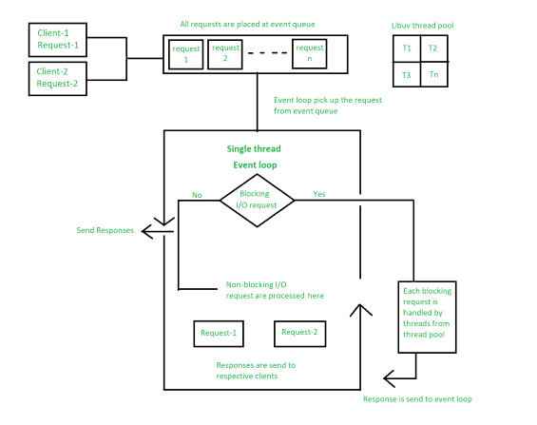

Slide 30
Node JS vs Other REs
Comparing Node.js with other runtime environments depends on specific use cases and requirements.
While Node.js has its strengths, it may not always be the best choice for every scenario.

Slide 31
Node JS vs Other REs
1. Node.js vs. Traditional Server-Side Languages (e.g., PHP, Ruby, Python):
- Node.js excels in handling concurrent connections and real-time applications due to its non-blocking, event-driven architecture.
- Traditional server-side languages often rely on blocking I/O, making them better suited for CPU-intensive tasks or applications with synchronous operations.
- Node.js is well-suited for applications requiring high scalability, real-time communication, and microservices architecture.

Slide 32
Node JS vs Other REs
2. Node.js vs. Java Virtual Machine (JVM) Languages (e.g., Java, Scala, Kotlin):
- JVM languages provide strong static typing and have a mature ecosystem with extensive libraries and frameworks.
- Node.js offers a lightweight runtime, faster startup times, and simpler development due to its single-language (JavaScript) approach.
- JVM languages are suitable for large enterprise applications, while Node.js is often preferred for building fast, scalable web applications and APIs.

Slide 33
Node JS vs Other REs
3. Node.js vs. .NET Runtime (C#, F#):
- The .NET runtime provides strong typing, a rich ecosystem, and seamless integration with Microsoft technologies.
- Node.js offers a lightweight runtime, platform independence, and a larger developer community.
- Node.js is commonly used for building lightweight web servers, microservices, and real-time applications, while .NET is preferred for Windows-based enterprise applications and services.

Slide 34
Node JS vs Other REs
4. Node.js vs. Python Runtime (e.g., Django, Flask):
Node.js is known for its high scalability and performance in handling concurrent requests due to its non-blocking I/O and event-driven architecture. Python, on the other hand, is generally considered more suitable for CPU-intensive tasks and data science applications.
Node.js has a large ecosystem of modules and packages available through npm, which facilitates rapid development and simplifies package management. Python has a mature ecosystem with libraries like NumPy and Pandas that are widely used in scientific computing and data analysis.
Node.js is predominantly used for web applications and APIs, while Python is popular for a wide range of applications, including web development, data analysis, machine learning, and scripting.

Slide 35
Node JS vs Other REs
5. Node.js vs. Java (Spring Boot):
Node.js provides a lightweight runtime and is well-suited for developing lightweight, real-time applications. Java, particularly with Spring Boot, is preferred for enterprise-level applications that require robustness, scalability, and extensive libraries for building complex systems.
Node.js has a fast startup time and is efficient in handling I/O-intensive tasks, while Java's Just-in-Time (JIT) compilation and static typing provide performance benefits for CPU-bound tasks.
- Java has a mature ecosystem and a strong emphasis on enterprise features like security, transaction management, and integrations with existing systems, making it a popular choice for large-scale applications. Node.js, on the other hand, is favored for its simplicity, developer productivity, and ease of use.

Slide 36
Installing Node.js and Setting Up a Dev Environment
1. Download Node.js:
- Visit the official Node.js website at https://nodejs.org.
- Click on the "Downloads" button to access the downloads page.
- Choose the appropriate version for your operating system (Windows, macOS, or Linux).
- Select the recommended version or choose a specific version if required.

Slide 37
Installing Node.js and Setting Up a Dev Environment
2. Run the Installer:
- Once the Node.js installation file is downloaded, run the installer.
- Follow the instructions provided by the installer.
- Choose the default installation settings or customize them based on your preferences.

Slide 38
Installing Node.js and Setting Up a Dev Environment
3. Verify the Installation:
- After the installation is complete, open a terminal or command prompt.
- Type the following command to check the installed Node.js version:
node -v
- If the version number is displayed, Node.js is successfully installed.

Slide 39
Installing Node.js and Setting Up a Dev Environment
4. Install a Code Editor:
- Choose a code editor that suits your preferences. Some popular options include Visual Studio Code, Sublime Text, Atom, or WebStorm.
- Download and install the code editor from the respective website.
- Follow the installation instructions provided by the code editor.

Slide 40
Installing Node.js and Setting Up a Dev Environment
5. Create a Project Directory:
- Choose a directory where you want to create your Node.js project.
- Open a terminal or command prompt.
- Navigate to the desired directory using the `cd` command. For example:
cd /path/to/project-directory

Slide 41
Installing Node.js and Setting Up a Dev Environment
6. Initialize a Node.js Project:
- In the terminal, run the following command to initialize a new Node.js project:
npm init
- Follow the prompts to provide information about your project (e.g., package name, version, entry point).
- Press enter or specify default options for fields that are not required.

Slide 42
Installing Node.js and Setting Up a Dev Environment
7. Install Dependencies:
- Once the project is initialized, you can start installing dependencies required for your project.
- Use the following command to install a package/module globally:
npm install -g package-name
- Alternatively, to install a package/module locally and save it as a dependency in your project's `package.json` file, use:
npm install package-name

Slide 43
Installing Node.js and Setting Up a Dev Environment
8. Start Coding:
- Open your chosen code editor and navigate to your project directory.
- Begin coding your Node.js application by creating or editing JavaScript files.
- Use the installed dependencies/modules in your code as required.

Slide 44
Getting Started with Node JS
1. Create a Project Directory:
- Choose a directory where you want to create your Node.js project.
- Open a terminal or command prompt.
- Navigate to the desired directory using the `cd` command. For example:
cd /path/to/project-directory

Slide 45
Getting Started with Node JS
2. Initialize a Node.js Project:
- In the terminal, run the following command to initialize a new Node.js project:
npm init
- Follow the prompts to provide information about your project (e.g., package name, version, entry point).
- Press enter or specify default options for fields that are not required.

Slide 46
Getting Started with Node JS
3. Create a JavaScript File:
- In your project directory, create a new file with a `.js` extension. For example, `index.js`.
- Open the file in a text editor or IDE of your choice.
4. Write Your First Node.js Program:
- In the `index.js` file, you can write your Node.js program. Let's start with a simple "Hello, World!" example.
- Add the following code to your `index.js` file:
console.log("Hello, World!");

Slide 47
Getting Started with Node JS
5. Save the File:
- Save the `index.js` file in your project directory.
6. Run the Node.js Program:
- In the terminal, navigate to your project directory.
- Run the following command to execute your Node.js program:
node index.js
7. Observe the Output:
- After running the command, you should see the output "Hello, World!" displayed in the terminal.

Slide 48
<thanks/>

